Slide 1
MATLAB Fundamentals

Slide 2
Objectives
Learning how real and complex numbers are assigned to variables.
Learning how vectors and matrices are assigned values using simple assignment, the color operator, and the linspace and logspace functions.
Understanding the priority rules for constructing mathematical expressions.
Gaining a general understanding of built-in functions and how you can learn more about them with MATLAB’s Help facilities.
Learning how to use vectors to create a simple line plot based on an equation.

Slide 3
The MATLAB Environment
MATLAB uses three primary windows-
Command window - used to enter commands and data
Graphics window(s) - used to display plots and graphics
Edit window - used to create and edit M-files (programs)
Depending on your computer platform and the version of MATLAB used, these windows may have different looks and feels.

Slide 4
Calculator Mode
The MATLAB command widow can be used as a calculator where you can type in commands line by line. Whenever a calculation is performed, MATLAB will assign the result to the built-in variable ans
Example:
>> 55 minus 16 ans = 39

Slide 5
MATLAB Variables
While using the ans variable may be useful for performing quick calculations, its transient nature makes it less useful for programming.
MATLAB allows you to assign values to variable names. This results in the storage of values to memory locations corresponding to the variable name.
MATLAB can store individual values as well as arrays; it can store numerical data and text (which is actually stored numerically as well).
MATLAB does not require that you pre-initialize a variable; if it does not exist, MATLAB will create it for you.

Slide 6
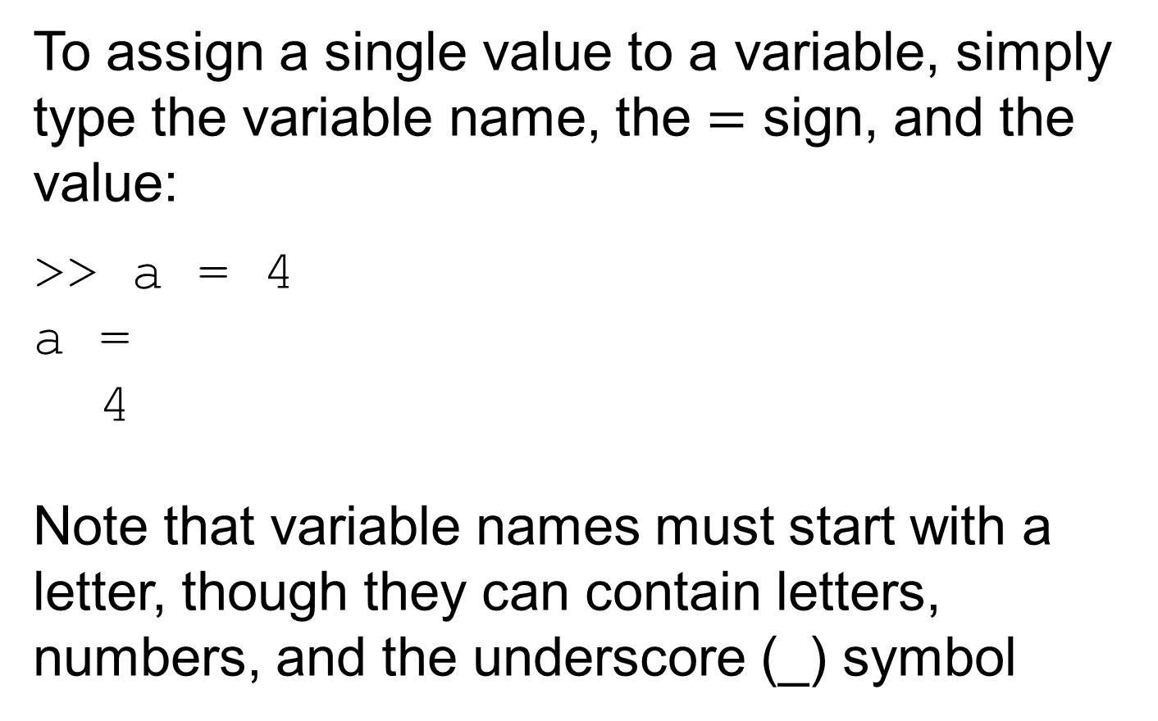
Scalars, 1
To assign a single value to a variable, simply type the variable name, the $=$ sign, and the value:
>> a = 4 a = 4
Note that variable names must start with a letter, though they can contain letters, numbers, and the underscore (_) symbol

Slide 7
Scalars, 2
You can tell MATLAB not to report the result of a calculation by appending the semi-colon (;) to the end of a line. The calculation is still performed.
You can ask MATLAB to report the value stored in a variable by typing its name:
>> a a = 4

Slide 8
Scalars, 3
You can use the complex variable i (or j) to represent the unit imaginary number.
You can tell MATLAB to report the values back using several different formats using the format command. Note that the values are still stored the same way, they are just displayed on the screen differently. Some examples are:
short - scaled fixed-point format with 5 digits
long - scaled fixed-point format with 15 digits for double and 7 digits for single
short eng - engineering format with at least 5 digits and a power that is a multiple of 3 (useful for SI prefixes)

Slide 9
Format Examples
>> format short; pi ans = 3.1416 >> format long; pi ans = 3.14159265358979 >> format short eng; pi ans = 3.1416e+000 >> pi*10000 ans = 31.4159e+003
Note - the format remains the same unless another format command is issued.

Slide 10
Arrays, Vectors, and Matrices
MATLAB can automatically handle rectangular arrays of data - one-dimensional arrays are called vectors and two-dimensional arrays are called matrices.
Arrays are set off using square brackets [ and ] in MATLAB
Entries within a row are separated by spaces or commas
Rows are separated by semicolons

Slide 11
Array Examples
>> a = [1 2 3 4 5 ] a = 1 2 3 4 5 >> b = [2;4;6;8;10] b = 2 4 6 8 10
Note 1 - MATLAB does not display the brackets
Note 2 - if you are using a monospaced font, such as Courier, the displayed values should line up properly

Slide 12
Matrices
A 2-D array, or matrix, of data is entered row by row, with spaces (or commas) separating entries within the row and semicolons separating the rows:
>> A = [1 2 3; 4 5 6; 7 8 9]
A = 1 2 3 4 5 6 7 8 9

Slide 13
Useful Array Commands
The transpose operator (apostrophe) can be used to flip an array over its own diagonal. For example, if b is a row vector, b’ is a column vector containing the complex conjugate of b.
The command window will allow you to separate rows by hitting the Enter key - script files and functions will allow you to put rows on new lines as well.
The who command will report back used variable names; whos will also give you the size, memory, and data types for the arrays.

Slide 14
Accessing Array Entries, 1
Individual entries within a array can be both read and set using either the index of the location in the array or the row and column.
The index value starts with 1 for the entry in the top left corner of an array and increases down a column - the following shows the indices for a 4 row, 3 column matrix:
1 5 9 2 6 10 3 7 11 4 8 12

Slide 15
Accessing Array Entries, 2
Assuming some matrix C: C = 2 4 9 3 3 16 3 0 8 10 13 17
C(2) would report 3
C(4) would report 10
C(13) would report an error!
Entries can also be access using the row and column:
C(2,1) would report 3
C(3,2) would report 0
C(5,1) would report an error!

Slide 16
Array Creation - Built In
There are several built-in functions to create arrays:
zeros(r,c) will create an r row by c column matrix of zeros
zeros(n) will create an n by n matrix of zeros
ones(r,c) will create an r row by c column matrix of ones
ones(n) will create an n by n matrix one ones
help elmat has, among other things, a list of the elementary matrices

Slide 17
Array Creation - Colon Operator
The colon operator : is useful in several contexts. It can be used to create a linearly spaced array of points using the notation start:diffval:limit where start is the first value in the array, diffval is the difference between successive values in the array, and limit is the boundary for the last value (though not necessarily the last value).
>>1:0.6:3 ans = 1.0000 1.6000 2.2000 2.8000

Slide 18
Colon Operator - Notes
If diffval is omitted, the default value is 1: >>3:6 ans = 3 4 5 6
To create a decreasing series, diffval must be negative: >> 5:-1.2:2 ans = 5.0000 3.8000 2.6000
If start+diffval>limit for an increasing series or start+diffval<limit for a decreasing series, an empty matrix is returned: >>5:2 ans = Empty matrix: 1-by-0
To create a column, transpose the output of the colon operator, not the limit value; that is, (3:6)’ not 3:6’

Slide 19
Array Creation - linspace
To create a row vector with a specific number of linearly spaced points between two numbers, use the linspace command.
linspace(x1, x2, n) will create a linearly spaced array of n points between x1 and x2 >>linspace(0, 1, 6) ans = 0 0.2000 0.4000 0.6000 0.8000 1.0000
If n is omitted, 100 points are created.
To generate a column, transpose the output of the linspace command.

Slide 20
Array Creation - logspace
To create a row vector with a specific number of logarithmically spaced points between two numbers, use the logspace command.
logspace(x1, x2, n) will create a logarithmically spaced array of n points between 10^{x1} and 10^{x2} >>logspace(-1, 2, 4) ans = 0.1000 1.0000 10.0000 100.0000
If n is omitted, 100 points are created.
To generate a column, transpose the output of the logspace command.

Slide 21
Character Strings & Ellipsis
Alphanumeric constants are enclosed by apostrophes (')
>> f = 'Miles ';
>> s = 'Davis'
Concatenation: pasting together of strings
>> x = [f s]
x =
Miles Davis
Ellipsis (...): Used to continue long lines
>> a = [1 2 3 4 5 ...
6 7 8]
a =
1 2 3 4 5 6 7 8
You cannot use an ellipsis within single quotes to continue a string. But you can piece together shorter strings with ellipsis
>> quote = ['Any fool can make a rule,' ...
' and any fool will mind it']
quote =
Any fool can make a rule, and any fool will mind it

Slide 22
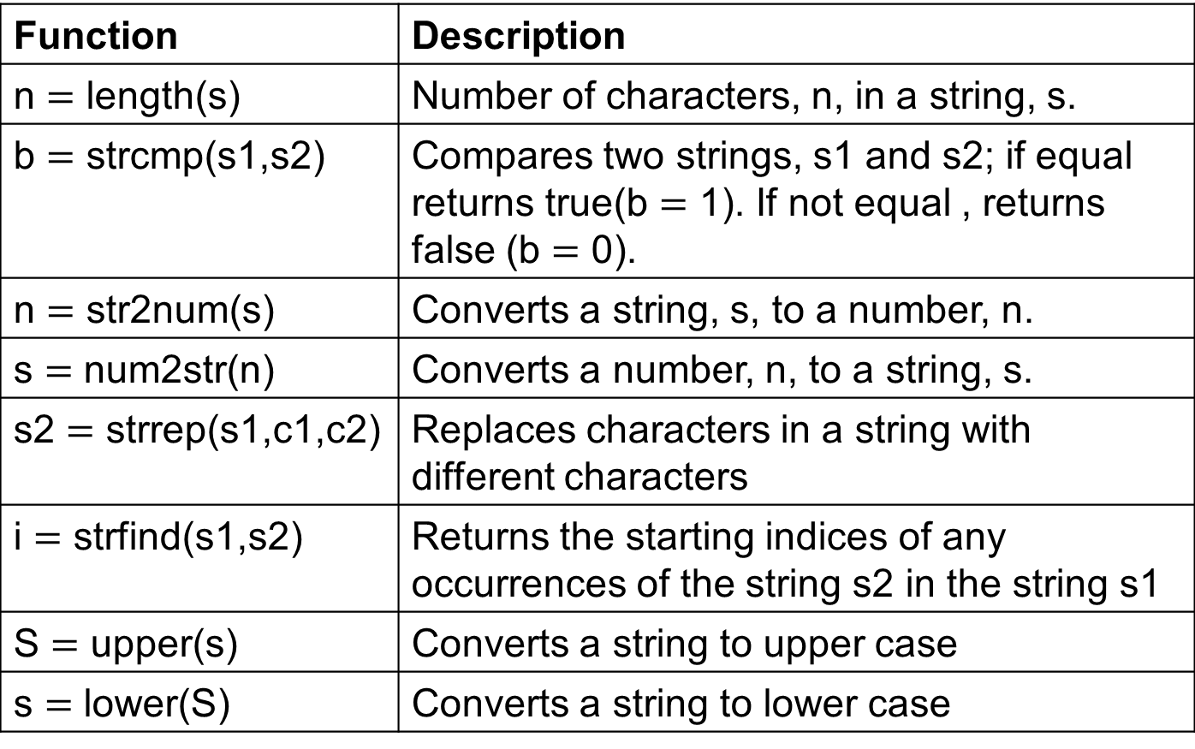
Some Useful Character Functions
Function | Description
n $=$ length(s) | Number of characters, n, in a string, s.
b $=$ strcmp(s1,s2) | Compares two strings, s1 and s2; if equal returns true(b $=$ 1). If not equal , returns false (b $=$ 0).
n $=$ str2num(s) | Converts a string, s, to a number, n.
s $=$ num2str(n) | Converts a number, n, to a string, s.
s2 $=$ strrep(s1,c1,c2) | Replaces characters in a string with different characters
i $=$ strfind(s1,s2) | Returns the starting indices of any occurrences of the string s2 in the string s1
S $=$ upper(s) | Converts a string to upper case
s $=$ lower(S) | Converts a string to lower case

Slide 23
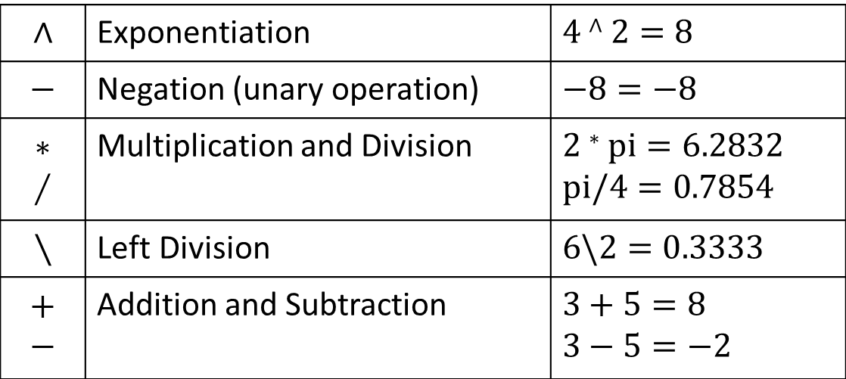
Mathematical Operations
Mathematical operations in MATLAB can be performed on both scalars and arrays.
The common operators, in order of priority, are:
$$∧$$ | Exponentiation | $$4∧2=8$$
$$−$$ | Negation (unary operation) | $$−8=−8$$
$$∗$$ $$∕$$ | Multiplication and Division | $$2∗pi=6.2832$$ $$pi/4=0.7854$$
$$∖$$ | Left Division | $$6\backslash 2=0.3333$$
$$+$$ $$−$$ | Addition and Subtraction | $$3+5=8$$ $$3−5=−2$$

Slide 24
Order of Operations
The order of operations is set first by parentheses, then by the default order given above:
y = -4 ^ 2 gives y = -16 since the exponentiation happens first due to its higher default priority, but
y = (-4) ^ 2 gives y = 16 since the negation operation on the 4 takes place first

Slide 25
Complex Numbers
All the operations above can be used with complex quantities (that is, values containing an imaginary part entered using i or j and displayed using i)
>> x = 2+i*4; (or 2+4i, or 2+j*4, or 2+4j)
>> y = 16;
>> 3 * x ans = 6.0000 +12.0000i >> x+y ans = 18.0000 + 4.0000i
>> x' ans = 2.0000 - 4.0000i

Slide 26
Vector-Matrix Calculations
MATLAB can also perform operations on vectors and matrices.
The * operator for matrices is defined as the outer product or what is commonly called “matrix multiplication.”
The number of columns of the first matrix must match the number of rows in the second matrix.
The size of the result will have as many rows as the first matrix and as many columns as the second matrix.
The exception to this is multiplication by a 1 by 1 matrix, which is actually an array operation.
The ^ operator for matrices results in the matrix being matrix-multiplied by itself a specified number of times.
Note - in this case, the matrix must be square!

Slide 27
Element-by-Element Calculations
At times, you will want to carry out calculations item by item in a matrix or vector. The MATLAB manual calls these array operations. They are also often referred to as element-by-element operations.
MATLAB defines .* and ./ (note the dots) as the array multiplication and array division operators.
For array operations, both matrices must be the same size or one of the matrices must be 1 by 1
Array exponentiation (raising each element to a corresponding power in another matrix) is performed with .^
Again, for array operations, both matrices must be the same size or one of the matrices must be 1 by 1

Slide 28
Built-In Functions
There are several built-in functions you can use to create and manipulate data.
The built-in help function can give you information about both what exists and how those functions are used:
help elmat will list the elementary matrix creation and manipulation functions, including functions to get information about matrices.
help elfun will list the elementary math functions, including trig, exponential, complex, rounding, and remainder functions.
The built-in lookfor command will search help files for occurrences of text and can be useful if you know a function’s purpose but not its name

Slide 29
Graphics
MATLAB has a powerful suite of built-in graphics functions.
Two of the primary functions are plot (for plotting 2-D data) and plot3 (for plotting 3-D data).
In addition to the plotting commands, MATLAB allows you to label and annotate your graphs using the title, xlabel, ylabel, and legend commands.

Slide 30
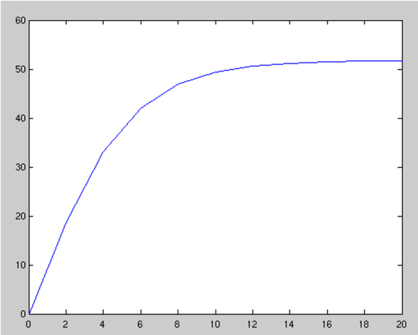
Plotting Example
t = [0:2:20]’; g = 9.81; m = 68.1; cd = 0.25; v = sqrt(g*m/cd) * tanh(sqrt(g*cd/m)*t); plot(t, v)

Slide 31
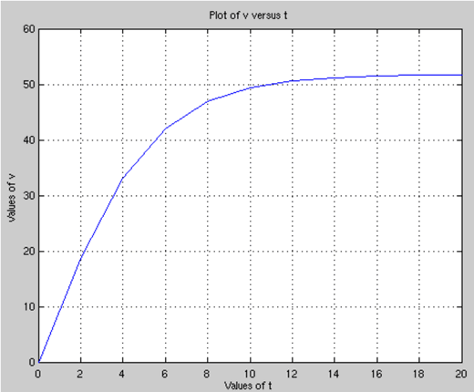
Plotting Annotation Example
title('Plot of v versus t') xlabel('Values of t') ylabel('Values of v') grid

Slide 32
Plotting Options
When plotting data, MATLAB can use several different colors, point styles, and line styles. These are specified at the end of the plot command using plot specifiers as found in Table 2.2.
The default case for a single data set is to create a blue line with no points. If a line style is specified with no point style, no point will be drawn at the individual points; similarly, if a point style is specified with no point style, no line will be drawn.
Examples of plot specifiers:
‘ro:’ - red dotted line with circles at the points
‘gd’ - green diamonds at the points with no line
‘m--’ - magenta dashed line with no point symbols

Slide 33
Other Plotting Commands
hold on and hold off
hold on tells MATLAB to keep the current data plotted and add the results of any further plot commands to the graph. This continues until the hold off command, which tells MATLAB to clear the graph and start over if another plotting command is given. hold on should be used after the first plot in a series is made.
subplot(m, n, p)
subplot splits the figure window into an m x n array of small axes and makes the p^{th} one active. Note - the first subplot is at the top left, then the numbering continues across the row. This is different from how elements are numbered within a matrix!

